Slide 1

#ShapeRMIT project update, developing strategy and next steps
1

Slide 2
Contents
#ShapeRMIT: The journey so far
Have you been involved in the conversation?
Illustrative feedback
The developing strategy
Transition from seven themes into developing goals
Next steps
Key dates
Ways to be engaged
2

Slide 3

ShapeRMIT: The journey so far
3

Slide 4

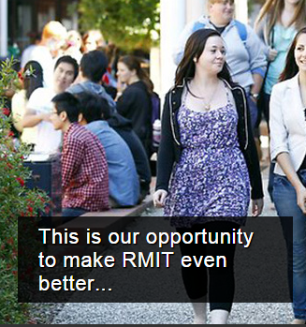
Have you been involved in the
conversation?
The #ShapeRMIT forum went live in April and hundreds of people have joined the conversation
27 March VCE session
1 June Academic Board
28 May Council retreat
25/27 May Student workshops (Melbourne campus)
26 June VC industry lunches
24 June Sustainability Forum
25 June Staff workshop (Melbourne campus)
2 July HDR student workshop
14 July VE student workshop
15 July Student Services workshop
17 July Bundoora campus staff workshop
20 July VCE Session
21-23 July Founders’ Day events and live forum
29 July Executive Leadership Forum
3 Aug Academic Board
Project Team engagement – meetings, seminars and presentations
RMIT Vietnam & RMIT Europe
4

Slide 5
What was the impact of #ShapeRMIT during Founders’ week?
On 23 July, there were 1,002 page views on shapeRMIT.com
Between 20 and 25 July, users spent an average of six minutes on shapeRMIT.com, visiting an average of five pages each
In the last month, 56.3 per cent of users were new visitors to shapeRMIT.com
88.2 per cent consider university to be a life changing experience for them
87.7 per cent think RMIT lives up to its reputation as a university of technology
Only 16 per cent would prefer to study online rather than coming into class
During the celebrations more than 550 students were surveyed and…
5
Notes:
Impact of #shapeRMIT
These stats were taken from a Google Analytics report from shapermit.com.
The first point is traffic to the website on the day of the forum (23 July)
The second point illustrates people are spending longer engaging with shapeRMIT
The third point shows there are more new visitors to shapermit.com as interest in the strategy grows
Student ambassadors at Brunswick, Bundoora and City campus used iPads with three questions to ask students attending Founders’ Day Celebrations. Total of 551 students were surveyed. The results above were taken from the final poll results on Friday morning.

Slide 6
How are people telling us they want to #ShapeRMIT?
(illustrative feedback)
“Research is extremely important for the universities; it shapes university image and reputation.”
“Employability is a key skill, one for the university to expose students to, rather than try and teach it.”
“Students are junior partners in a public institution and they are investing in their future and not just buying a qualification.”
“Keep class sizes manageable so students are appreciative of the opportunity they have and staff aren’t overworked and enjoy engaging with students.”
6

Slide 7
How are people telling us they want to #ShapeRMIT?
(illustrative feedback)
“I would like to see RMIT seize the opportunity to restate its commitment to make the ‘public good’ of its research, teaching and learning…”
“Apply a global lens across everything we do to become a true multinational operation.”
“We are ‘industry facing’. The comment time and time again from potential employers and industry is that there is an ‘RMIT difference’.”
“Live up to the old motto of ‘a skilled hand and a cultivated mind’. RMIT has always been known for its graduates being job-ready – this needs to be re-emphasised.”
7

Slide 8
#ShapeRMIT live forum
http://youtu.be/pEP7XoFVork
8

Slide 9

Live forum discussion
9

Slide 10

The developing strategy
10

Slide 11

The developing strategy
INITIAL THEMES
THREE DIRECTIONS*
Employability and enterprise
Student experience and support
Research and innovation
Shaping the world
Life-changing experiences
RMIT
Mission and Values
Learning and Teaching
Engagement with industry and community
Global presence and impact
Workforce and systems
capability
Passion with purpose
*Underpinned by 7 goals – see next slide
14
11

Slide 12
Three directions enabled by goals
Research and innovation
Industry and enterprise
Global reach and outlook
Student experience
Connected pathways
Shaping the world
Life-changing experiences
RMIT
Mission and Values
“Skilled hands,
cultivated minds”
Passion with purpose
Simplicity
Resources
12

Slide 13
Focus and structure of the Strategy
Life-changing experiences
Student Experience
RMIT gives a transformative experience to all students from all backgrounds. The experience integrates learning, campus, social and work connections.
Connected Pathways
RMIT courses create pathways between work and learning at every level from advanced research to the foundations of learning. RMIT courses are rigorous, relevant and practice-led.
13

Slide 14
Focus and structure of the
Strategy
Passion with purpose
Simplicity
RMIT’s people are empowered and supported to lead in the fields where their passion can be applied to achieve our goals. In a complex world, RMIT will simplify its structures and processes.
Resources
Our use of resources is driven by our goals. We create sustained value in our management of financial, physical, social and environmental resources.
17
14

Slide 15
Focus and structure of the
Strategy
Shaping the world
Research and Innovation
We create knowledge and impact across diverse areas of specialist expertise, social and economic need. We excel in applied, interdisciplinary research and shape wider innovation.
Industry and Enterprise
Our courses, research, staff and partnerships are connected to the leading edges of industry and enterprise.
Global Reach and Outlook
We are a leading global institution, successfully supporting innovative economic and workforce development in key locations around the world.
15
18
15

Slide 16
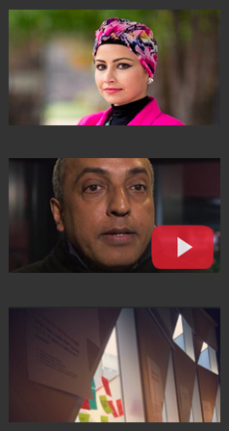
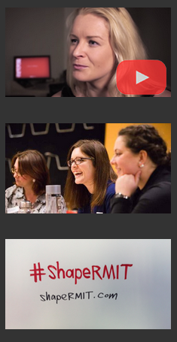
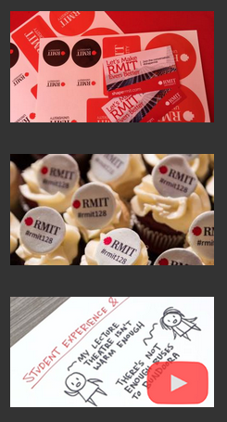
#ShapeRMIT: Next steps
16

Slide 17
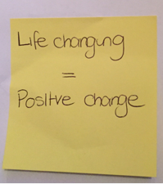
Next steps: How can you and your teams
stay involved?
The conversation is continuing in many ways:
Get online! #ShapeRMIT online forum
Catalyst kit – materials online to help you conduct workshops (available online)
Directions Paper – paper to be released that covers the journey so far, key feedback and illustrates RMIT’s future direction
How will you #ShapeRMIT?
17

Slide 18
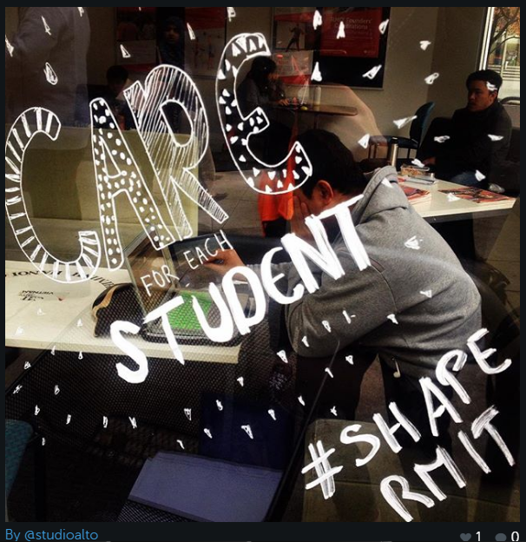
Directions Paper
Key engagement piece to take the project to the next level
Canvassing themes such as:
What you’ve said, so far
Where we are today?
Where we are going?
What happens next?
18

Slide 19
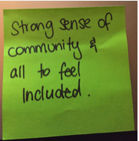
Key dates
Mid August Directions Paper launch
August + September Drafting and testing the thinking
October – November Finalising draft
November - December Launch & Implementation
19

Slide 20
Thank you
Want to get in touch?
https://shapermit.com/
shape.rmit@edu.au
#ShapeRMIT Project team contacts
Madeleine Babiolakis | David Glanz
Tom Bentley | Anand Kulkarni
Ciannon Cazaly | Jess Lee-Ack
Gabriela D’Souza | Louise Robinson
Amber Douglas | Renzo Scacco
Claire Homsey
20

